Slide 1
AdventurWorks SQL Agent

Slide 2
Agenda
Starting Point
Problem
Goal
Tasks
Datamodel
Infrastructure
Disclaimer & Extension

Slide 3
Starting Point
SQL (Structured Query Language) used to retrieve data from databases (SELECT * FROM HumanResources.Employe WHERE ....
LLMs are quiet good in writing “short” SQL already
Many Analysts write SQL and use a lot of time for this

Slide 4
Problem
Database(s) can contain thousand of tables and LLM (and Analysts as well) don’t know the structure

Slide 5
Goal
GIVE ME AN EXAMPLE SQL QUERY FOR THE ADVENTORUWORKS2016 DB
Create an Agent translating business questions from analysts into SQL for the AdventureWorks2016 DB

Slide 6
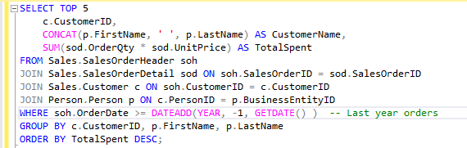
eXAMPLE
GIVE ME AN EXAMPLE SQL QUERY FOR THE ADVENTORUWORKS2016 DB
Which are the top 5 customers who have spent the most on orders in the last year?

Slide 7
TASK(s)
Create a Vectordatabase(s) containing information about the datamodel:
Documentation about Tables
Documentation about columns
Datamodel itself (relationship between tables)
For a given Business Questions find relevant Tables, Columns and Relationships between tables
For relevant tables also all intermediate tables need to be included -> Path in Graph between Tables need to be found: First approach Minimal Spanning Tree
Add information in an optimal way to an prompt

Slide 8
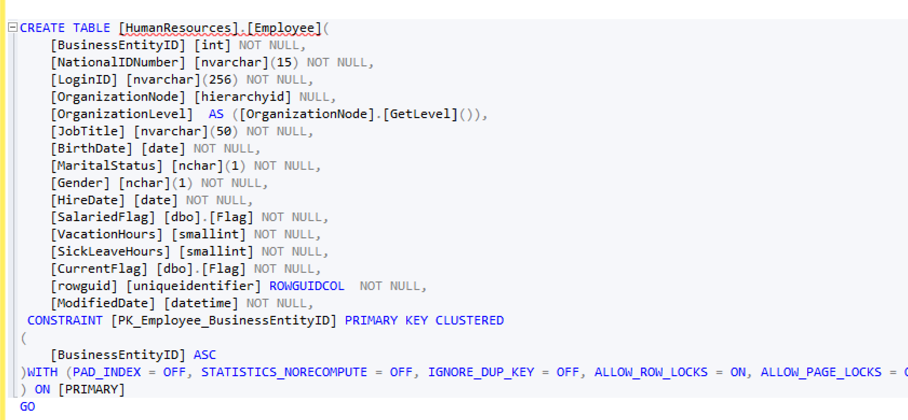
dATA - TAbledefinitions

Slide 9
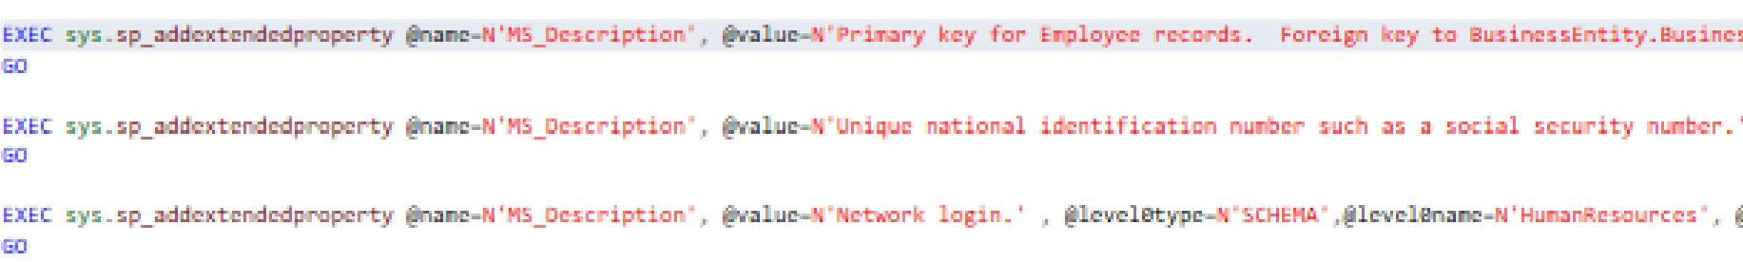
dATA - Extendedproperties

Slide 10
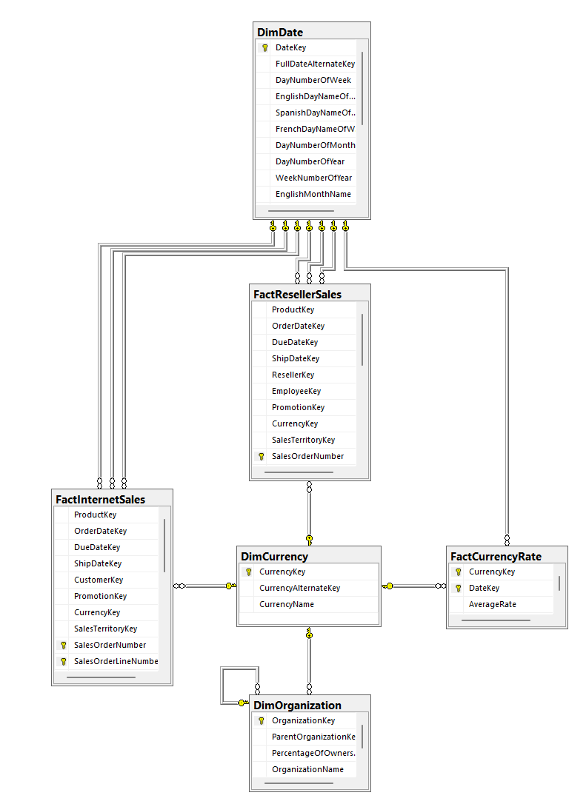
dATAMODEL
Relationship between Tables can be identifieds by
Foreign Keys
Potentially also just by Table & Column names:
Example:
HumanrRessource.Shift Table contains column “ShiftID”
HumanResources.EmployeeDepartmentHistory also contains column “ShiftID”
In AdventurWorks we also have a ForeignKey
In “Real World” Example no FKs might exists and ID naming could also be different: Most comen :
HumanrRessource.Shift -> Column “ID” as PK
HumanResources.EmployeeDepartmentHistory -> ShiftID

Slide 11
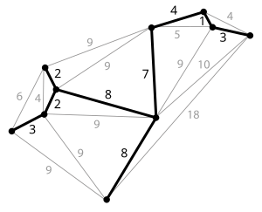
dATAMODEL
With the vectordatabase we can identify relevant tables and columns but to write an SQL query we also need all intermediate tables in the data model
-> I compute a minimal spanning tree in the datamodel (weights =1)
For a given undirected weighted graph an a subset of points a minimal spanning tree is the set of edges connection all the points while minimising the weights

Slide 12
Architecture
Question
2
MS SQL
5
Python
4
OpenAI API
Execute SQL
Send prompt to OpenAI API
1
3
Similarity search for relevant tables and columns to build promt
Stores emmbeddings of extended properties
Postgres

Slide 13
Infrastruktur
Postgres DB to store Vectordatabase
pgvector extension
MS SQL Light Database to Host AdventureWworks Data
SSMS to query MS SQL DB
pgAdmin to querry PostGres DB
LLM API Endpoint (OpenAI)
Visual Studio & CMD to install pgvector extension
ENV variables to store secretes
-> Setup.txt

Slide 14
Disclaimer
AdventourWork is public data and that knowledge might interfere with my tests
Minimal Spanning Tree calculation is not working yet, currently all tables and columns are passed to Prompt (700+ rows...)

Slide 15
Extensions
Optimize prompt length for better resource utilization.
Instead of bulk loading all embeddings into the database, develop an ETL process that supports incremental updates, deletions, and insertions.
Scale the solution to accommodate larger applications and data models, such as CRM systems, application databases, and data warehouses that are not publicly accessible
Utilize indexes in PostgreSQL to enhance search performance.
Perform embedding calculations directly within PostgreSQL for greater efficiency compared to Python.
Front-end
SECURITY: Authentication against Front-end & MSSQL DB & Postgres DB -> AD-groups...

